Slide 1
Theory of Automata
Lecture #20-21

Slide 2
Context Free Grammar
A context-free grammar (CFG) is a set of recursive rewriting rules (or productions) used to generate patterns of strings.
A context-free grammar (CFG) is a formal grammar in which every production rule is of the form
V → w

Slide 3
CFG Components
A CFG consists of the following components:
a set of terminal symbols, which are the characters of the alphabet that appear in the strings generated by the grammar.
a set of non-terminal symbols, which are placeholders for patterns of terminal symbols that can be generated by the non-terminal symbols.

Slide 4
CFG Components…
A CFG consists of the following components:
a set of productions, which are rules for replacing (or rewriting) non-terminal symbols (on the left side of the production) in a string with other non-terminal or terminal symbols (on the right side of the production).
a start symbol, which is a special non-terminal symbol that appears in the initial string generated by the grammar.

Slide 5
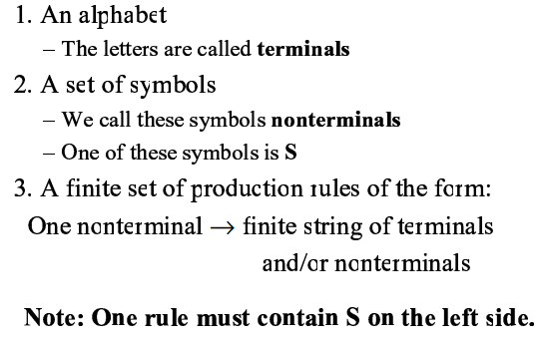
CFG Components

Slide 6
String Generation from CFG
To generate a string of terminal symbols from a CFG, we
Begin with a string consisting of the start symbol
Apply one of the productions with the start symbol on the left hand size, replacing the start symbol with the right hand side of the production

Slide 7
String Generation from CFG…
Repeat the process of selecting non-terminal symbols in the string, and replacing them with the right hand side of some corresponding production, until all non-terminals have been replaced by terminal symbols.

Slide 8
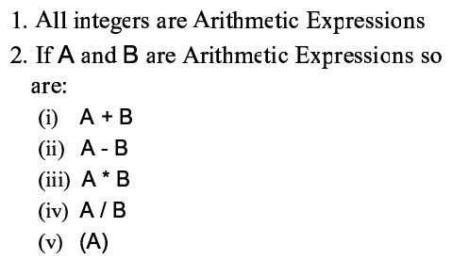
Arithmetic Expression

Slide 9
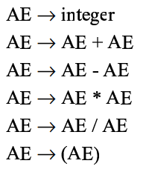
Production Rules

Slide 10
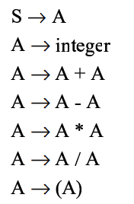
Production Rules

Slide 11

Backus Normal Form

Slide 12
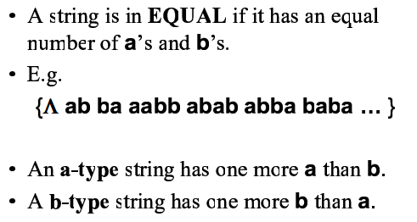
Definitions

Slide 13
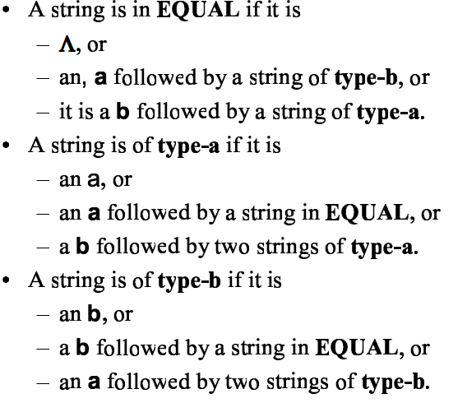
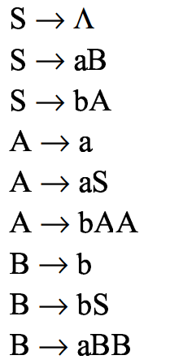
Definition of Equal

Slide 14
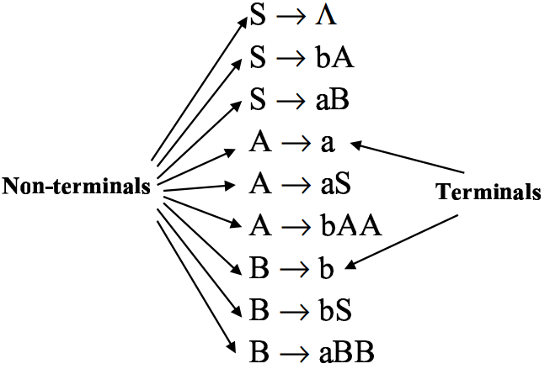
Production Rules

Slide 15

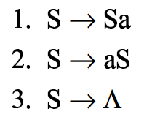
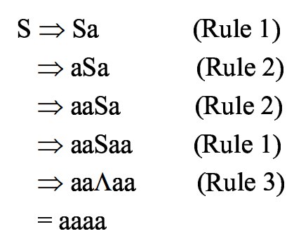
Simple String Generation
Production Rules
Generate aaaa String from given CFG

Slide 16
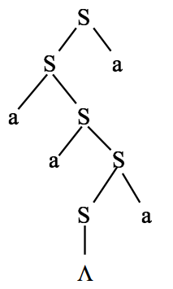
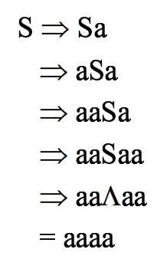
Parse Tree

Slide 17
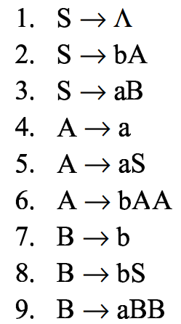
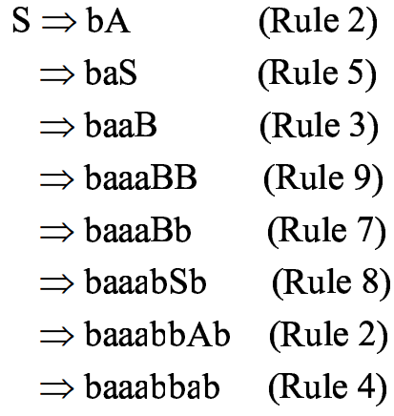
EQUAL
Generate baaabbab from language of equal

Slide 18
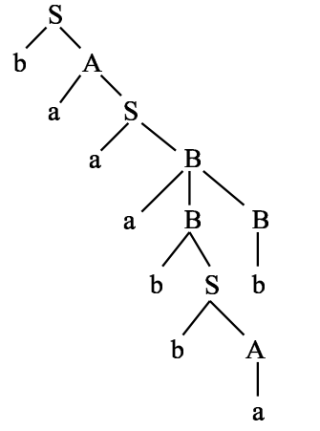
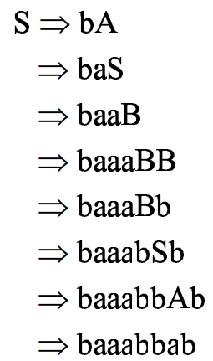
Parse Tree of EQUAL

